Slide 1
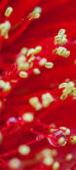
Banksia Banksia Rar Rar Rar.
Banksia Banksia best by far,
we’re rough we’re tough we’re hard to bluff.
So come on Banksia do your stuff,
B A N K S I A GO BANKSIA

